Slide 1
SECURE DATA HIDING IN IMAGES USING STEGANOGRAPHY
CAPSTONE PROJECT
Presented By: Paras Nitin Salunke
Student Name : Paras Nitin Salunke
College Name & Department : MIT Art, Design and Technology University B. Tech CSE

Slide 2
OUTLINE
Problem Statement
Technology used
Wow factor
End users
Result
Conclusion
Git-hub Link
Future scope

Slide 3
Problem Statement
In today's digital age, secure communication is paramount, yet traditional encryption methods can attract unwanted attention. There is a need for a user-friendly, secure tool that uses steganography to hide secret messages within images. This tool must ensure client-side data processing, offer robust security features like AES encryption, and provide an intuitive, responsive user experience. Stega-Shield addresses these needs by offering a modern, secure, and efficient solution for steganography and encrypted communication.

Slide 4
Technology used
React.js (v19.0.0): Component-based UI for a seamless user experience.
Vite (v6.1.0): High-speed development and optimized build process.
Crypto-Js (v4.2.0): AES encryption for enhanced message security.
Tailwind CSS (v4.0.6): Ensures a responsive and modern design.
Canvas API: Efficient image manipulation and message encoding/decoding.
React Icons (v5.4.0): Icon components used within the application.
Visual Studio Code: Preferred code editor for efficient development and debugging.
GitHub: Version control and collaborative development platform used for managing the project.

Slide 5
Wow factors
Image-based Steganography: Securely hide text messages within images.
Encryption Support: Optional password protection using AES encryption.
Multiple Encoding Options: Basic Encoder, Advanced Encoder, and Decoder.
Client-side Processing: Ensures no data leaves the user's browser.
Real-time Image Preview: Provides immediate feedback on the encoding process.
Responsive Design: Built with Tailwind CSS for a seamless user experience across devices.
Security Features: Includes AES encryption for password-protected messages.
Support for Various Image Formats: Handles PNG, JPG, and GIF formats.

Slide 6
End users
Individuals who want to securely hide and encode secret messages within images.
Users who need to protect sensitive information using steganography and encryption.
People looking for a user-friendly and secure way to encode and decode hidden messages in images.
Developers or enthusiasts interested in exploring steganography and encryption techniques through a modern web application.

Slide 7
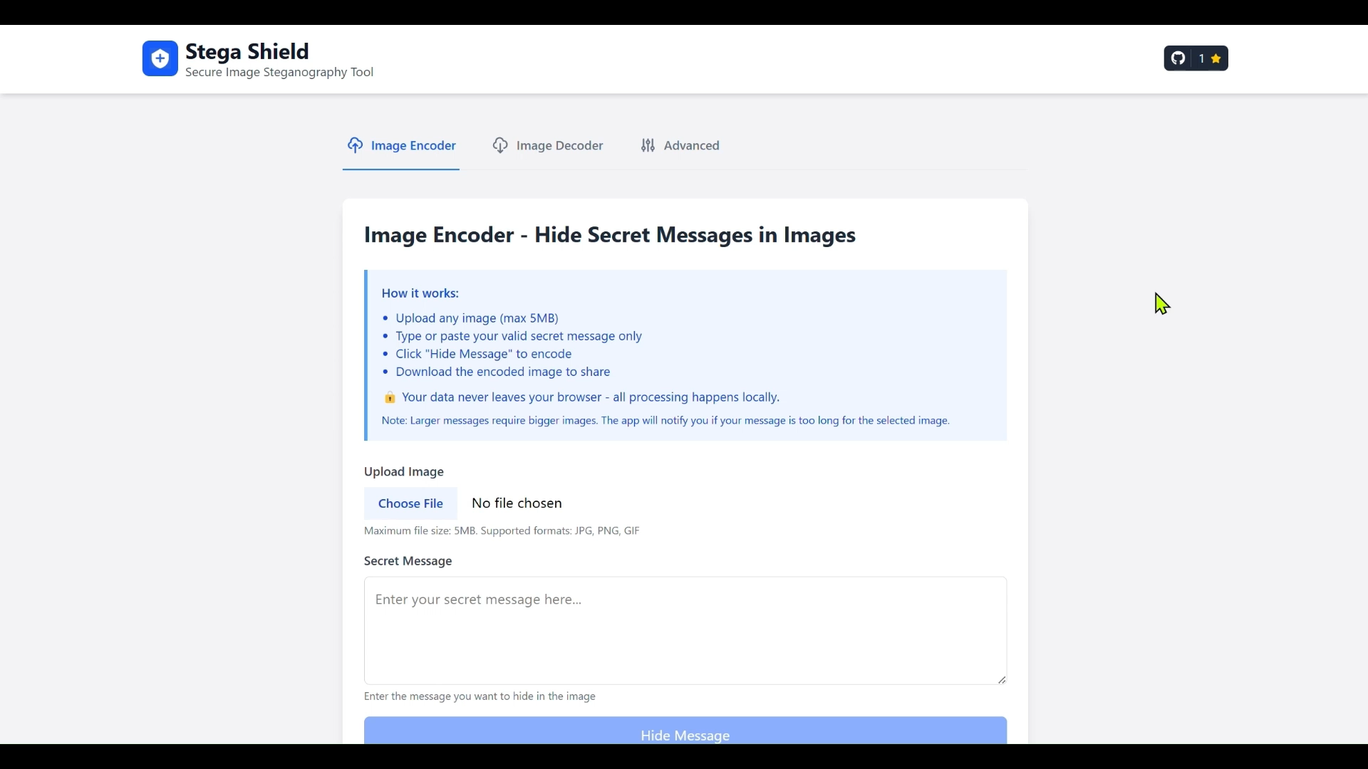
Results (DEMO VIDEO)

Slide 8
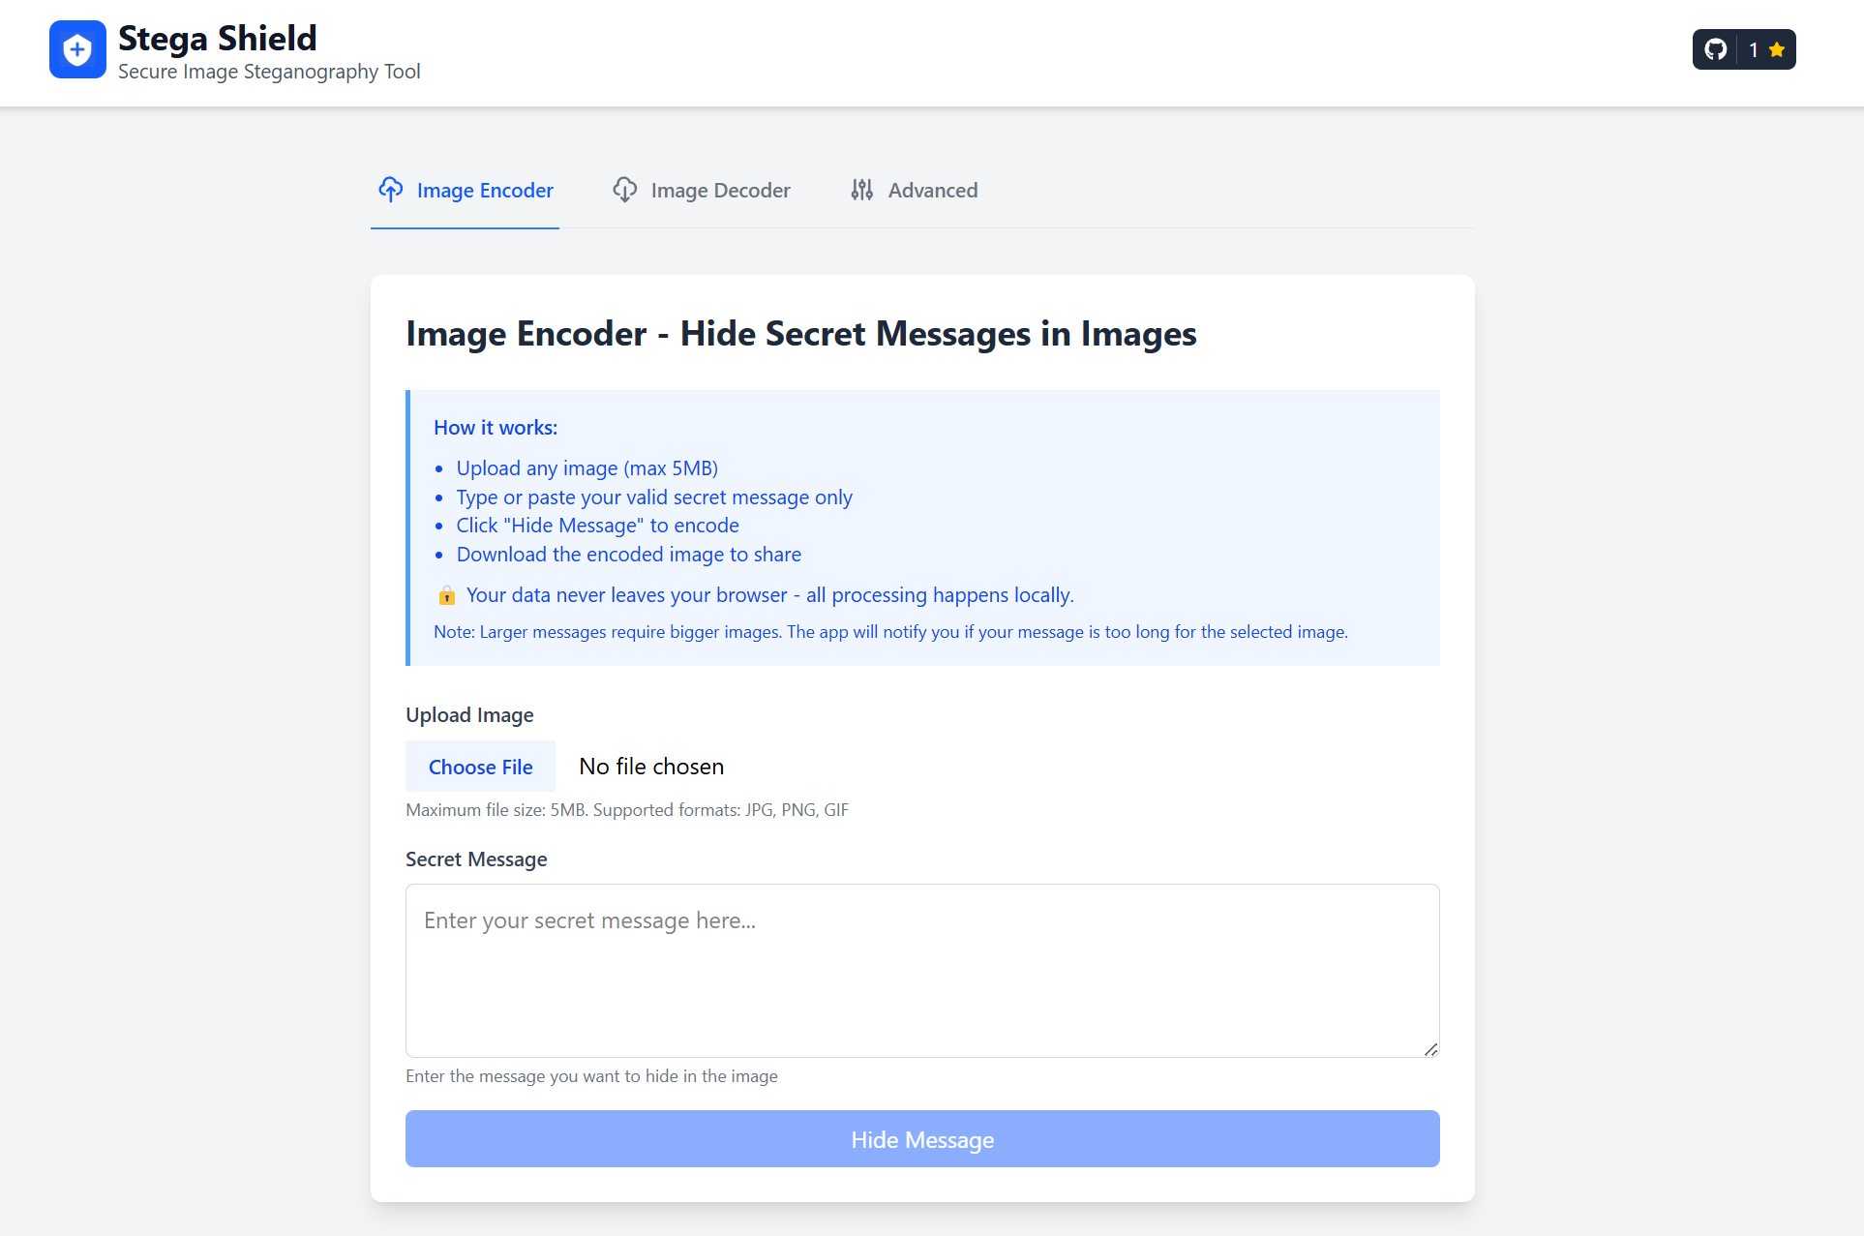
Results (SCREENSHORTS)

Slide 9
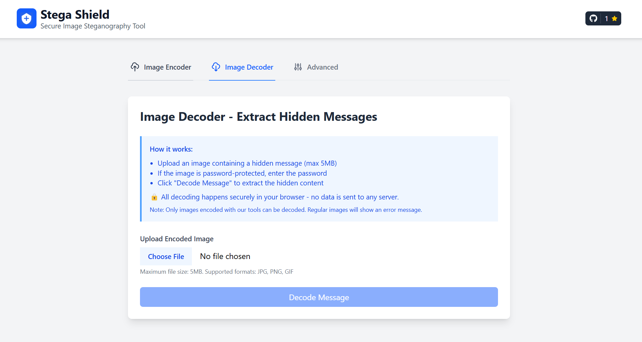

Slide 10
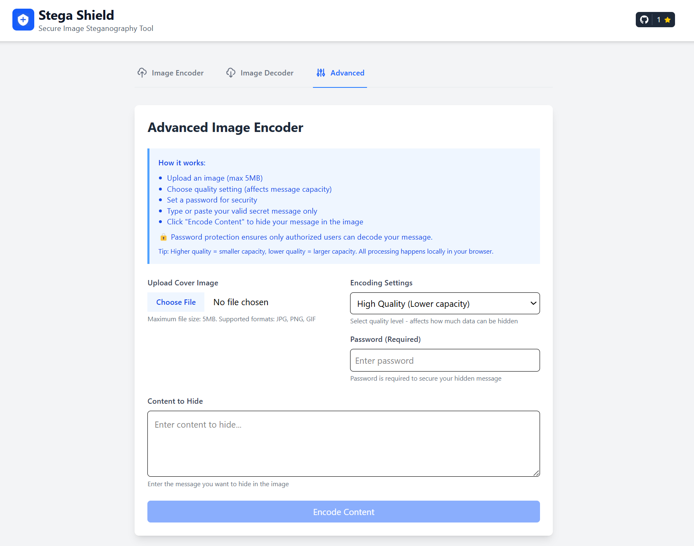

Slide 11
Conclusion
The Stega-Shield project is a modern and secure web application designed to hide secret messages within images using advanced steganography and encryption techniques. By leveraging cutting-edge technologies such as React and Tailwind CSS, Stega-Shield offers a seamless and responsive user experience. The project ensures that all data processing occurs on the client-side, which guarantees that no data leaves the user's browser, thus maintaining a high level of security. The inclusion of AES encryption provides optional password protection, adding an extra layer of security for hidden messages. Additionally, features like real-time image preview and responsive design enhance the overall usability of the application. The project is well-documented and easy to set up, encouraging contributions from the developer community. As an open-source project licensed under the MIT License, Stega-Shield promotes collaboration and continuous improvement, making it a valuable tool for secure communication.

Slide 12
GitHub Link
GitHub Link: https://github.com/ParasSalunke/Stega-Shield
Demo Link: https://stega-shield.vercel.app

Slide 13
Future scope(optional)
Support for Video & Audio Steganography: Expanding beyond images for broader data concealment.
Mobile App Integration: Bringing secure steganography to Android & iOS devices.
AI-Powered Steganography: Leveraging machine learning to optimize and enhance message embedding techniques.
Cloud Storage & Sharing Options: Securely store and share encoded images while maintaining privacy.
Blockchain-Based Authentication: Ensuring message authenticity and preventing unauthorized alterations.

Slide 14
THANK YOU

